Slide 1
Use of Models
Derived from White Rose Maths Calculation Policy.
This document is an overview of the models and representations outlined in the STM calculation policy and is to support the teaching of different mathematical concepts. Included are explanations of the benefits of using these models and to show the links between different operations.

Slide 2
Addition and Subtraction

Slide 19
Multiplication and Division

Slide 23
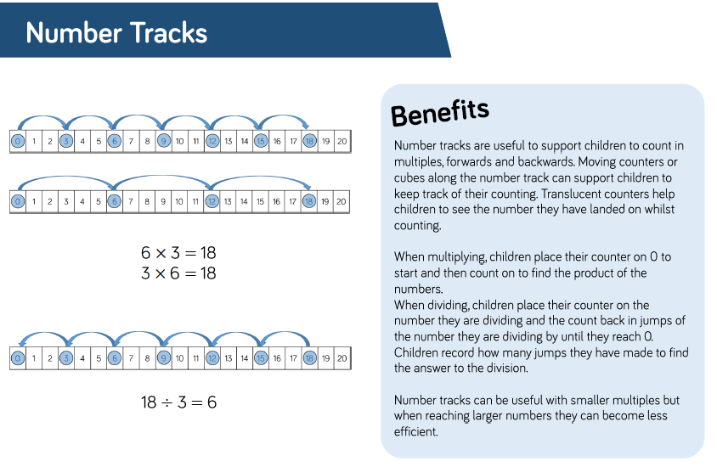

Slide 24
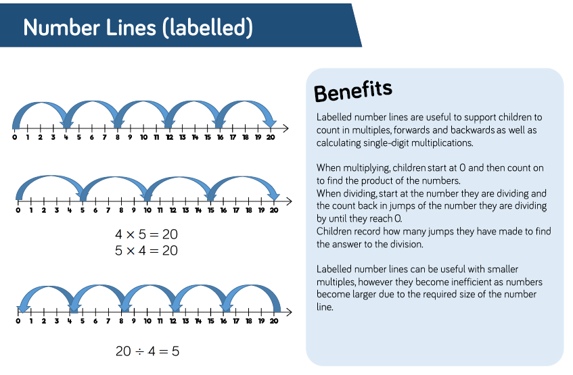

Slide 26
