Slide 1
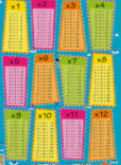
Times Tables
The following document sets out an overview of the multiplication facts that are to be taught in each year group according to the National Curriculum. This document is derived from White Rose and provides a range of models and representations that may be used to teach the appropriate facts.

Slide 2
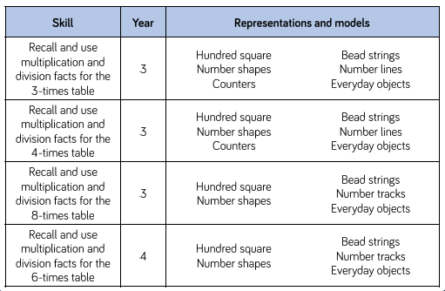
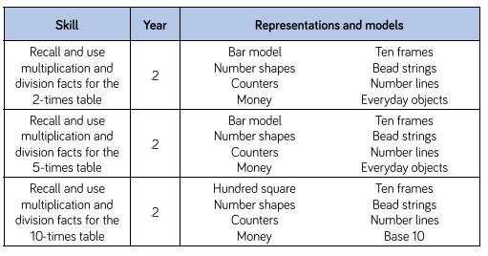
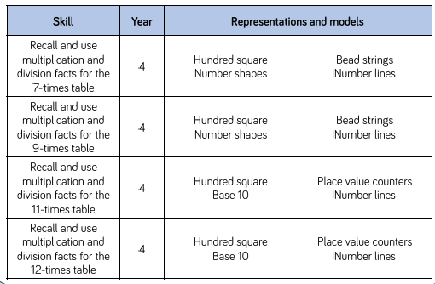
National Curriculum guidelines
Year 1: Count, read and write numbers to 100
in numerals; count in multiples of twos, fives
and tens.
Year 5/6: Ensure Year 4 requirement is secure
-recall multiplication and division facts for
multiplication tables up to 12 × 12

Slide 4
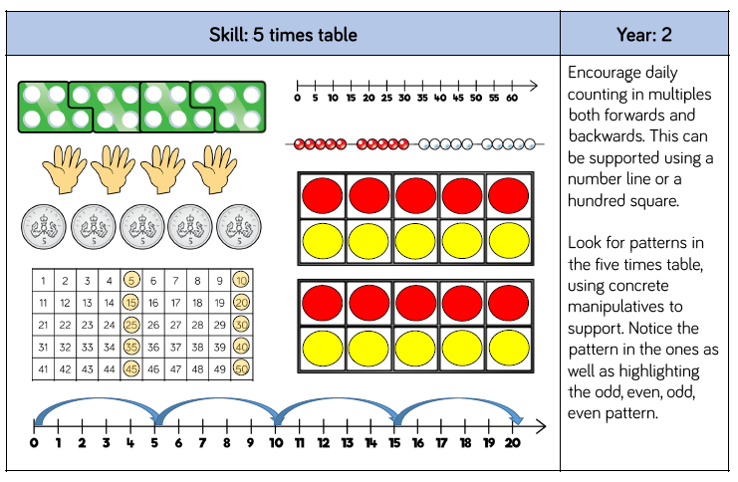

Slide 5
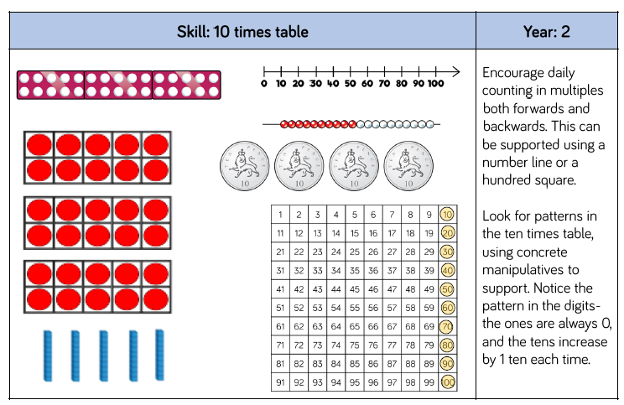

Slide 6
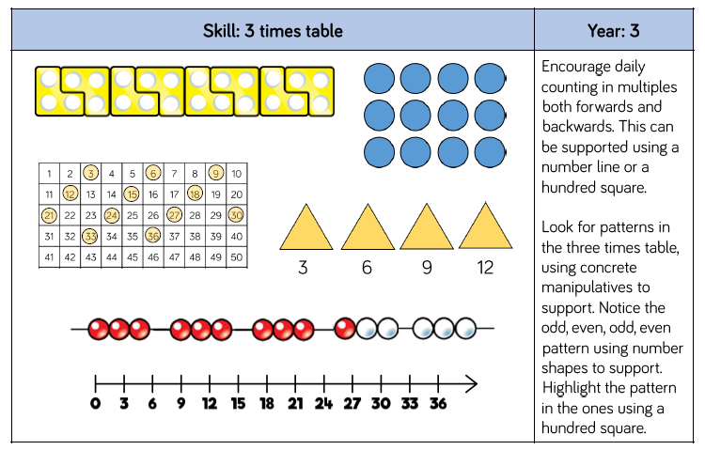

Slide 7
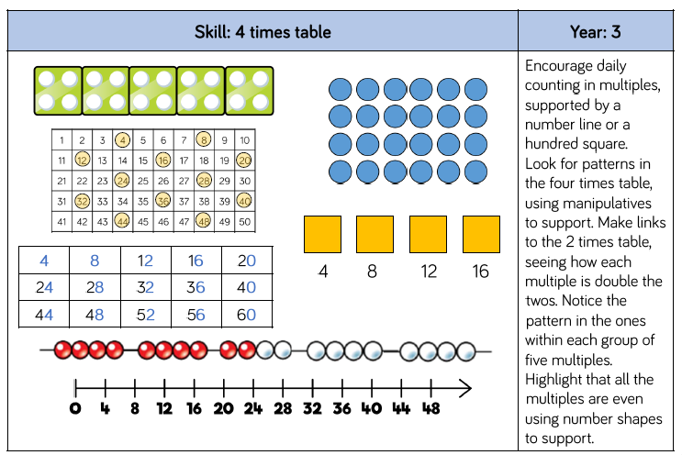

Slide 8
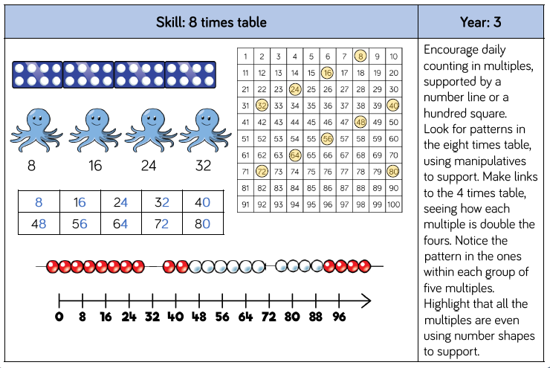

Slide 9
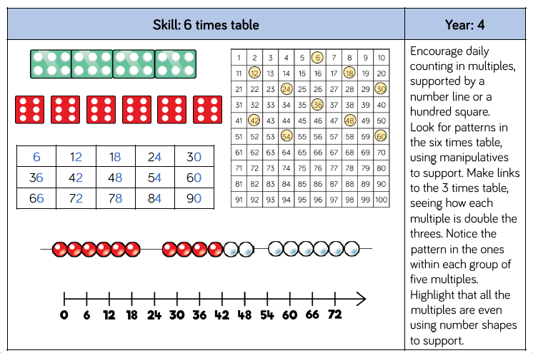

Slide 10
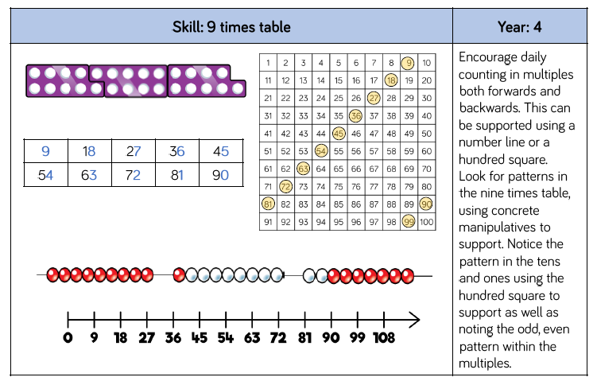

Slide 11
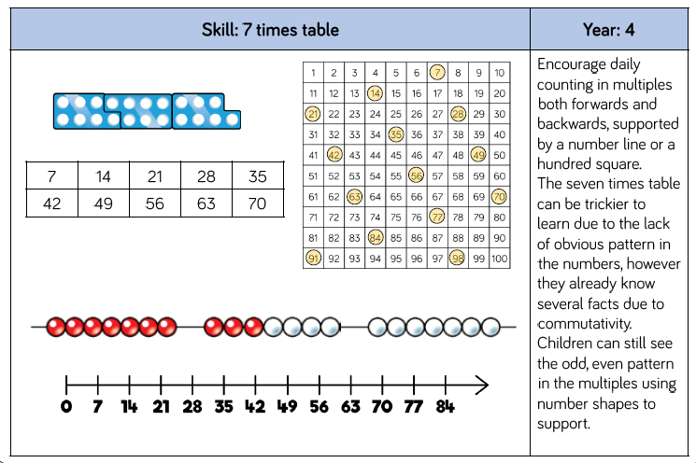

Slide 12
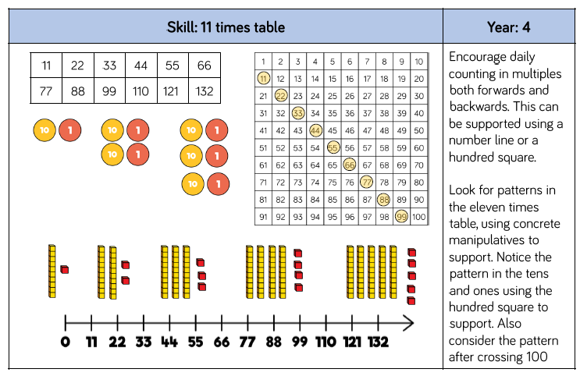

Slide 13
